Slide 1
Model-Based PID Ball Balancing System

Slide 2
Authors:
Supervisors:
Laith AlKhdour - Computer Engineering - 20190130
Tarek Salameh - Computer Engineering - 20190217
Omar Abujuma - NIS Engineering - 20190561
Dr. B. Sababha
Eng. R. Al-Harasis

Slide 3
Introduction:
The Model-Based PID Ball Balancing System is a project that aims to develop a control system that can balance a ball on a surface by the use of the Proportional-Integral-Derivative control system.
We were asked to use the PID controllers and place them into a ball-balancing system.
The values of the PID controller parameters K_{P}, K_{I}, and K_{D} are manually modified using a potentiometer.
The system will bend the surface using a servo motor based on the position of the ball moving above that surface and mitigate any errors that affects its balance through the use of inputs from an ultrasonic.

Slide 4
Objectives:
Balancing a ball on a surface using the PID controller
The ability to tune the values of K_{P}, K_{I}, and K_{D} to match the desired performance of the controller
Deploying a PID controller into real-life projects.

Slide 5
Hardware Design:
One Arduino Uno Controller
One Ultrasonic Sensor to measure the distance to the ball
One Servo Motor to balance the ball one the main surface
Three potentiometers to tune K_{P}, K_{I}, and K_{D}
The main body “a wooden surface and a wooden ground”

Slide 6
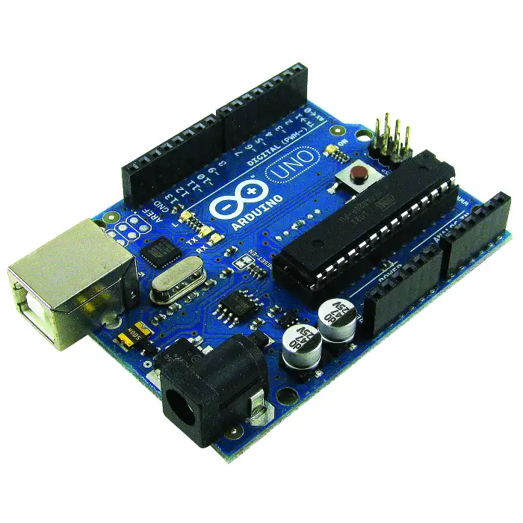
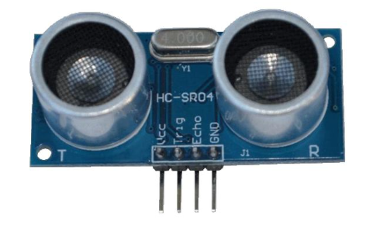
Hardware Design:
Arduino Uno: The main component that we’ll be using in our design, it is the microcontroller that we’ll be using to write down our code and to make the motor and the sensor work properly with each other.
Ultrasonic Sensor: The sensor emits short bursts of sound, and listens for the echo off nearby objects, by measuring the time of flight, distance can be computed

Slide 7
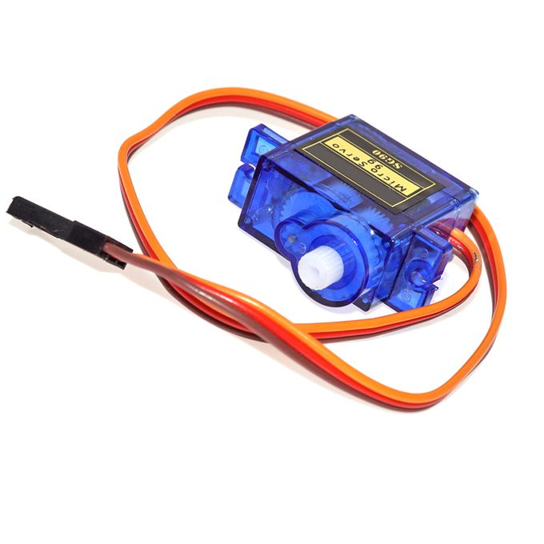
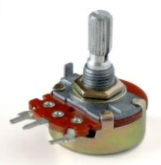
Hardware Design:
Servo Motor: The motor is important in our design to set the angle for the ball to be balanced.
Potentiometer: We used the potentiometer to tune the values of PID Controllers.

Slide 8
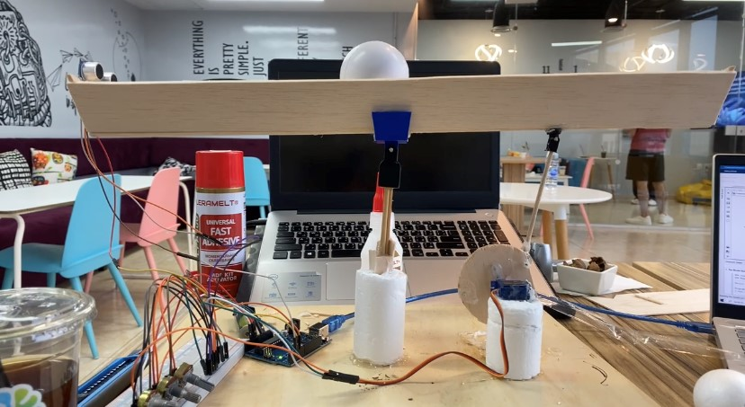
Hardware Design:
Complete Hardware Design:

Slide 9
Software Design:
A Simulink code that contains the following:
The Main Code that contains the following:
Ultrasonic Sensor Input as a Feedback.
PID control system.
Servo Motor Output.
Serial Communication Port that is connected to Servo Motor Output and works with the Scope Code.
The Scope Code that contains the following:
COM Port that monitors the Servo Motor behaviour and displays it at a scope output.

Slide 10
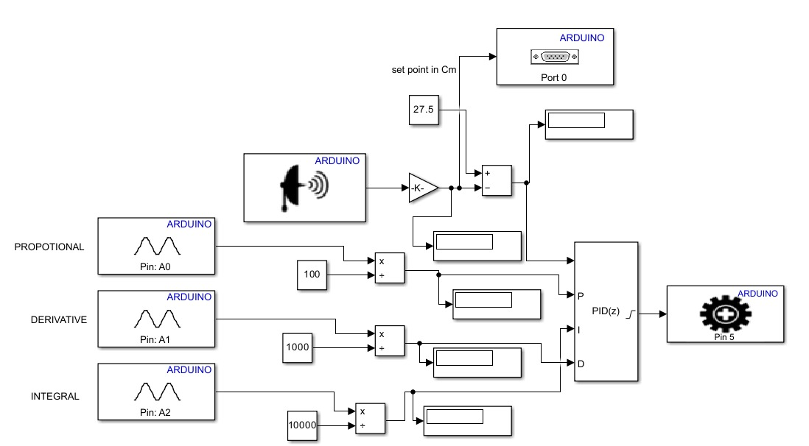
Software Design:
Main Code:

Slide 11
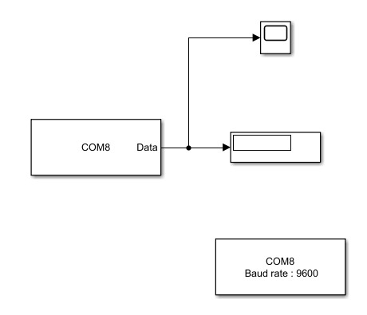
Software Design:
Scope Code:

Slide 12
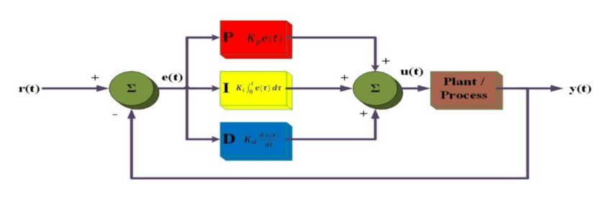
PID Controller:
Proportional: the error is multiplied by a gain. The higher is the gain, the faster is the response. However, very high gain may cause instability.
Integral: is used to remove steady-state error. However, integral action increases the overshoot and reduces system stability.
Derivative: is used to improve the transient response by reducing overshoot.

Slide 13
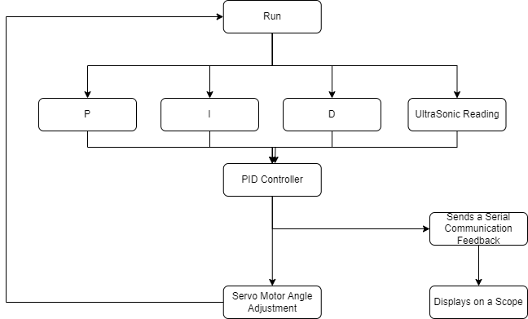
Flowchart:

Slide 14
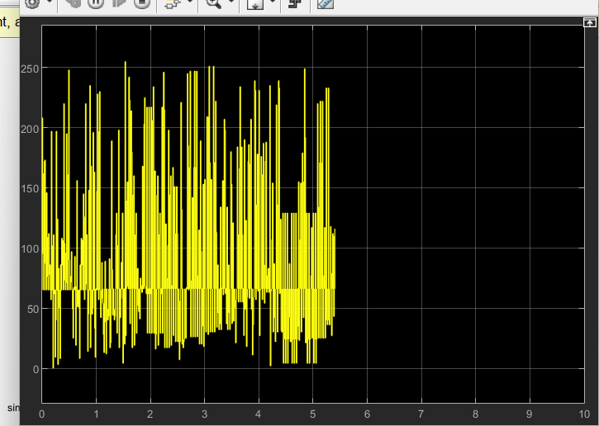
Results:
We realized that the scope’s readings were drifting away from stability before the it became stable when the ball reached the center.

Slide 15
Conclusion:
The PID controller is being developed in order to develop a reliable control system that can keep a ball in balance on a surface.
The device uses ultrasonic sensors to measure how far the ball is from the target position and servo motors to bend the surface horizontally in order to adjust the ball's position.
By manually adjusting the values of the PID controller parameters KP, KI, and KD using a potentiometer, the system's performance can be further improved.

